Slide 1
Course Request of Linear Algebra
Textbook: Linear algebra with applications (Eighth Edition)
Ref. to mainland student : 线性代数（第六版） 同济大学数学系编
Total Mark=Regular grade(40%)+final exam grade (60%)
Regular grade is based on final exam grade+2 or 3 exercise+midterm exam
email：tzhuwh@jnu.edu.cn

Slide 2
CHAPTER ONE
Matrices and System Equations
Objective:To provide solvability conditions of a linear equation Ax=b .

Slide 3
Outline
Systems of linear Equations
Row Echelon From
Matrix Arithmetic
Matrix Algebra
Elementary Matrices
Partitioned Matrices

Slide 4
Motivative Example (curve fitting)
Given three points( )( )( ),find a polynomial of degree 2 passing through the three given points.
Solution: Let the polynomial be
Where a,b and c are to be determined
Ax=b

Slide 5
1.1 Systems of linear Equations
A linear equation with n unknows
A linear system of m equations in n unknows
where the aij's and bi's are all real numbers
(m×n)

Slide 6
Systems of linear Equations（II）
By a solution of an m×n system,we mean an ordered n-tuple of numbers
If a linear system has no solution, we say that the system is inconsistent.
If a linear system has at least one solution, we say that the system is consistent.
The set of all solutions of a linear system is called the solution set of the system.

Slide 7
2×2 Systems
let's exam geometrically a system of the form
each equation can be represented as a line in the plane

Slide 8
Equivalent Systems
Two systems of equations involving the same variables are said to be equivalent if they have the same solution set.
three operations that can be used on a system to obtain an equivalent system:
I. Exchange any two equations
II. Both sides of an equation be multied by a non-zero real number
III. A multiple of one equation may be added to another

Slide 9
n×n Systems
A system is said to be in strict triangular form if ,in the kth equation, the coefficients of the first k-1 variables are all zero and the kth variable's coefficient is nonzero
we can used a method named "back substitution" to get the solution of a strict triangular system

Slide 10
n×n Systems
we can associate with that system a 3×3 array of numbers whose entries are the coefficients of the x_{i}'s.
coefficient matrix augment matrix
square

Slide 11
Question: Why transform to matrix form?
To provide a systematic approach and to use computer resource.

Slide 12
n×n Systems
Corresponding to the three operations used to obtain equivalent systems,the folloing row operations may be applied to the augmented matrix:
I. Interchange any two equations
I. Interchange two row
II. Both sides of an equation be multied by a non-zero real number
II. Multiply a row by a nonzero real number
III. A multiple of one equation may be added to another
III. Replace a row by its sum with a multiple of another row

Slide 13
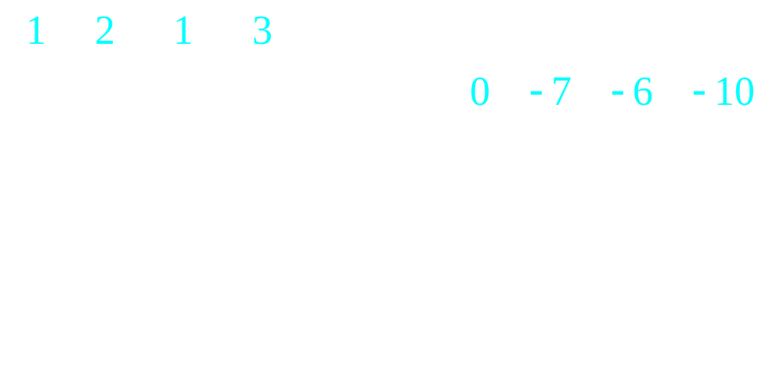
n×n Systems
pivot
pivotal row
pivot
pivotal row

Slide 14
n×n Systems
Example:

Slide 15
1.2 Row echelon Form
pivotal row
pivotal row
strict triangle form?

Slide 16
Row echelon Form(II)
The coefficient matrix that we end up with is not in strict triangle form; it's in staircase, or echelon, form. The horizontal and vertical line segments in the array for the coefficient matrix indicate the structure of the staircase form. Note that the vertical drops 1 for each step,but the horizontal span for a step can be more than 1.

Slide 17
Row echolen form
I. The first nonzero entry in each nonzero row is 1.
II. If row k does not consist entirely of zeros, the number of leading zero entry in row k+1 is greater than the number of leading zero entry in row k
III. If there are rows whose entries are all zero,they are below the rows having nonzero entries.

Slide 18
Row echolen form
The process of using row operations I,II,and III to transform a linear system into one whose augment matrix is in row echelon form is called Gaussian elimination
If the row echelon form contains the row(0,0,...0|1),the system is inconsistant.
A linear system is said to be overdetermined if there are more equations than unknows. Overdetermined systems are usually(not always) inconsistant.
A linear system is said to be Underdetermined if there are more unknows than equations.Underdetermined systems are usually(not always) consistant with infinitely solutions.

Slide 19
Example

Slide 20
Reduced Row Echelon Form
A matrix is said to be in reduced row echelon
form if:
(i) The matrix is in row echelon form.
(ii) The first nonzero entry in each row is the
only nonzero entry in its column.
The process of using elementary row operations
to transform a matrix into reduced row echelon
form is called Gauss-Jordan reduction.

Slide 21
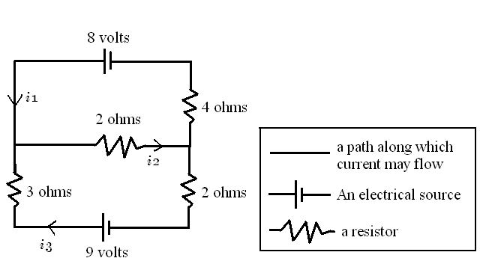
Application : Electrical Networks

Slide 22
Application : Electrical Networks (end)
Kirchhoff’s Laws:
1. At every node the sum of the incoming currents equals the
sum of the outgoing currents.
2. Around every closed loop the algebraic sum of the voltage
must equal the algebraic sum of the voltage drops.

Slide 23
Homogeneous systems
A linear system is said to homogeneous if the contants on the right hand side are all zero. Homogeneous systems are always consistant.
trival solution (0,0,...,0)
An m×n homogeneous system has nontrival solution if n>m.

Slide 24
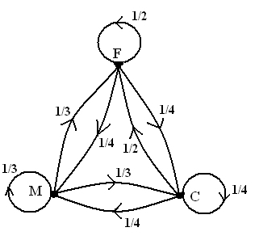
Application 4: Economic Models For
Exchange of Goods (P.25)
F M C
F
M
C
1/2
1/4
1/4
1/3
1/3
1/3
1/2
1/4
1/4

Slide 25
1.3 Matrix Arithmetic
Notation:
Matrix: Vector:

Slide 26
1.3 Matrix Arithmetic
Matrix:

Slide 27
1.3 Matrix Arithmetic
Two matrices A and B are said to equal if for each i and j
Scalar Multiplication
If A is an m×n matrix and α is a scalar, then αA is an m×n matrix whose(i,j) entry is αaij
Matrix Addition
If A=(aij) and B=(bij) are both m×n matrices, then the sum A+B is the m×n matrix whose (i,j)entry is aij+bij

Slide 29
We define A-B to be A+(-1)B

Slide 30
O represents the matrix, with the same dimensions as A, whose entries are all zero.
A+O=O+A=A
we will refer to O as the zero matrix.
A+(-1)A=O=(-1)A+A
-A=(-1)A

Slide 31
Matrix Multiplication and linear Systems
One Equation in Several Unknows
We set
define the product Ax by

Slide 32
For a linear equation with n Unknows
We let
and define the product Ax

Slide 33
M equations in n Unknows

Slide 34
define the product Ax by
example: write the following system of equations as a matrix equation of the form Ax=b

Slide 35
define the product Ax by

Slide 36
If a₁,a₂,...,a_{n} are vectors in R^{n} and c₁,c₂,...,c_{n} are scalars , then a sum of the form
is said to be a linear combination of the vectors a₁,a₂,...,a_{n}
if A is an m×n matrix and x is a vector in R^{n}, then
A linear system is consistent if and only if b can be written as a linear combination of the column vectors of A

Slide 37
More generally, it's possible to multiply a matrix A times a matrix B if the number of columns of A equals the number of rows of B.The first column of AB is Ab₁, then second column of Ab is Ab₂, and so on. Thus the product AB is the matrix whose columns are Ab₁,Ab₂,...,Ab_{n}.
If and , then the
Matrix Multiplication ,
where .

Slide 39
Application : Production Costs
Table 1
Production Costs Per Item (dollars)
 | Product
Expenses | A | B | C
Raw materials | 0.1 | 0.3 | 0.15
Labor | 0.3 | 0.4 | 0.25
Overhead and miscellaneous | 0.1 | 0.2 | 0.15

Slide 40
Application : Production Costs (cont.)
Table 2
Amount Produced Per Quarter
 | Season
Product | Summer | Fall | Winter | Spring
A | 4000 | 4500 | 4500 | 4000
B | 2000 | 2600 | 2400 | 2200
C | 5800 | 6200 | 6000 | 6000

Slide 41
Application : Production Costs (cont.)
Solution:

Slide 42
Application : Production Costs (cont.)
Solution:

Slide 43
Application : Production Costs (end)
Solution:
Table3
Amount Produced Per Quarter
 | Season
 | Summer | Fall | Winter | Spring | Year
Raw materials | 1,870 | 2,160 | 2,070 | 1,960 | 8,060
Labor | 3,450 | 3,940 | 3,810 | 3,580 | 14,780
Overhead and miscellaneous | 1,670 | 1,900 | 1,830 | 1,740 | 7,140
Total production cost | 6,990 | 8,000 | 7,710 | 7,280 | 29,980

Slide 44
AS ordinary algebra,if an expression involves both multiplication and addition and there are no parentheses to indicate the order of operations, multiplication carried out before additions. This is true for both scalar and matrix multiplication.
The transpose of an (m × n) matrix A is the (n ×
m) matrix B defined by for j=1,…,n and
i=1,…,m. The transpose of A is denoted by A^{T.}
An (n × n) matrix A is said to be symmetric if A^{T}=A .

Slide 45
Application : Information Retrieval (P.39)
Suppose that our database, consists of these book titles:
  B1. Applied Linear Algebra
  B2. Elementary Linear Algebra
  B3. Elementary Linear Algebra with Applications
  B4. Linear Algebra and Its Applications
  B5. Linear Algebra with Applications
  B6. Matrix Algebra with Applications
  B7. Matrix Theory
The collection of key words is given by the following alphabetical
list：
    algebra, application, elementary, linear, matrix, theory

Slide 46
Application : Information Retrieval (cont.)
Table 8
Array Representation for Database of Linear Algebra Books
 | Books
Key Words | B1 | B2 | B3 | B4 | B5 | B6 | B7
algebra | 1 | 1 | 1 | 1 | 1 | 1 | 0
application | 1 | 0 | 1 | 1 | 1 | 1 | 0
elementary | 0 | 1 | 1 | 0 | 0 | 0 | 0
linear | 1 | 1 | 1 | 1 | 1 | 0 | 0
matrix | 0 | 0 | 0 | 0 | 0 | 1 | 1
theory | 0 | 0 | 0 | 0 | 0 | 0 | 1

Slide 47
Application : Information Retrieval (end)
If the words we are searching for are applied, linear, and algebra,
then the database matrix and search vector are given by
If we set y= A^{T}x, then

Slide 48
1.4 Matrix Algebra
The algebraic rules used for real numbers may or may not work when matrices are used. In this section we examine which algebraic rules work for matrices and which do not.
Warning: In general, AB≠BA. Matrix multiplication is not commutative.

Slide 49
Some Matrix Properties
Let be scalars,A,B and C be matrices
with proper dimensions.
(Commutative Law)
(Associative Law)
(Associative Law)
(Distributive Law)
(Distributive Law)

Slide 50
Some Matrix Properties (cont.)

Slide 51
Definitions
The n×n identity matrix is the matrix I=
example:
Def. An (n × n) matrix A is said to be nonsingular
or invertible if there exists a matrix B such that
AB=BA=I. The matrix B is said to be a
multiplicative inverse of A. And B is denoted
by A⁻¹.

Slide 52
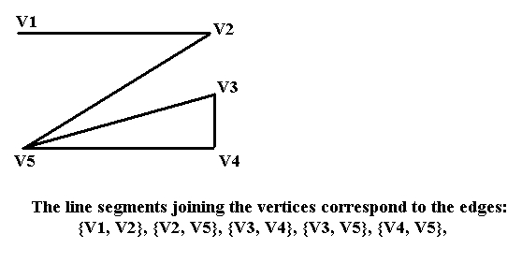
Application: Networks and Graphs (P.54)

Slide 53
Application : Networks and Graphs (cont.)
DEF.

Slide 54
Application : Networks and Graphs (end)
Theorem 1.3.3.
If A is an n × n adjacency matrix of a graph and represents
the ijth entry of A^{k}, then is equal to the number of walks of length
from to V_{i} to V_{j}.

Slide 55
1.5 Elementary Matrices
In this section, we view the process of solving a linear system in terms of matrix multiplications rather than row operations. Given a linear system Ax=b, we can multiply both sides by a sequence of special matrices to obtain a equivalent system in row echelon form. The special matrices we will used are called elementary matrices. we will used them to see how to compute the inverse of a nonsingular matrix and also to obtain an important matrix factorization.

Slide 56
Equivalent systems
Given an m × n linear system Ax=b, we can obtain an equivalent system by multiplying both sides of the equation by a nonsingular m × m matrix M:
Ax=b (1)
MAx=Mb (2)
to transform the system Ax=b to a simpler form that is easier to solve,we can apply a sequence of nonsingular matrices E₁,...,E_{k} to both sides of equation.
E₁...E_{k}Ax=E₁...E_{k}b
Ux=c

Slide 57
Elementary Matrices
If we start with an identity matrix,and the perform exactly one elementary row operation, the resulting matrix is called an elementary matrix.
Type I ( ): Obtained by interchanging rows i and j
from identity matrix.
Type II ( ): Obtained from identity matrix by
multiplying row i with .
Type III ( ): Obtained from identity matrix by adding to row j.

Slide 58
Type I:

Slide 59
Type II:

Slide 60
Type III :

Slide 61
Elementary Row / Column Operation
means performing type I row operation on A.
means performing type II row operation on A.
means performing type III row operation on A.
means performing type I column operation on A.
means performing type II column operation on A.
means performing type III column operation on A.

Slide 62
If E is an elementary matrix, then E is nonsingular and E⁻¹ is an elementary matrix of the same type.
With
The solution set of a linear equations is invariant under three types row operation.
→ and have the solution set.

Slide 63
Row Equivalent
Def. A matrix B is row equivalent to A if there exists a finite sequence of elementary matrices such that
Theorem1.5.2
(a) A is nonsingular.
(b) Ax=0 has only the trivial solution 0.
(c) A is row equivalent to I.

Slide 64
Proof of Theorem 1.5.2
(a) (b)
Let be a solution of Ax=0.
(b) (c)
Let A ~ U, where U is in reduced row echelon form.
Suppose U contains a zero row.
by Th1.2.1, Ux=0 has a nontrivial solution
thus A~I.
(c) (a)
A~I → A= E₁ …… E_{k} for some E₁ … E_{k}
∵ each E_{i} is nonsingular.
∴ A is nonsingular. (by Th.1.2.1)
row

Slide 65
Corollary1.5.3
Ax=b has a unique solution A is nonsingular.
Pf: " “ The unique solution is .
" " Suppose is the unique solution and A is
singular.
is also a solution of Ax=b.
A is nonsingular.

Slide 66
Method For Computing
If A is nonsingular and row equivalent to I, so
there exists elementary matrices such that
then,
E_{k}…E₁(A | I)= (E_{k}…E₁‧A | E_{k}…E₁‧I) ( by )
= (I | E_{k}…E₁‧I) ( by )
= (I | A⁻¹)

Slide 67
Example . (P.63)
Q: Compute A⁻¹ if .
Sol:

Slide 68
Example 4. (cont.)
Q: Compute A⁻¹ if .
Sol:

Slide 69
Diagonal and Triangular Matrices
Def. An n × n matrix A is said to be upper triangular if a_{ij}=0 for i > j and lower triangular if a_{ij}=0 for i > j.
Def. An n × n matrix B is diagonal if a_{ij}=0 whenever i ≠ j.
Triangular Factorization
If an n × n matrix C can be reduced to upper triangular form
using only row operation III, then C has an LU factorization.
The matrix L is unit lower triangular, and if i > j, then l_{ij} is the multiple of t he jth row subtracted from the ith row during the reduction process.

Slide 70
Example 6.
row operation III
Mark:

Slide 71
1.6 Partitioned Matrices
Often it is useful to think of a matrix as being composed of a number of submatrices. A matrix C can be partitioned into smallermatrices by drawing horizontal lines between rows and vertical lines between the columns. The smaller matrices are often refer to as blocks

Slide 73
One useful way of partitioning a matrix is into columns

Slide 74
In general, if A is an m×n matrix and B is an n×r matrix that has been patitioned into columns(b₁,...,b_{r}) ,then the block multipication of A times B is given by

Slide 75
For example:

Slide 76
In general, if A is an m×n matrix and B is an n×r matrix that has been patitioned into columns(b₁,...,b_{r}) ,then the block multipication of A times B is given by
In particular,

Slide 77
Let A be an m×n matrix, if we partition A into rows,then
Let B be an n×r matrix, in general,

Slide 78
For example:

Slide 79
Block Multiplication
Let A be an M×n matrix and B an n×r matrix. It's often useful to partition A and B and express the product in terms of the sub matrices of A and B.
Case1: If , where B₁ is an n×t matrix and B₂ is an n×(r-t) matrix, then
Case2: If , where A₁ is a k×n matrix and A₂ is an (m-k)×n matrix, then

Slide 80
Block Multiplication
Case3: Let , where A₁ is a m×s matrix and A₂ is an m×(n-s) matrix, B₁ is an s×t matrix and B₂ is an (n-s)×t matrix, then

Slide 81
Block Multiplication
In general, if the blocks have the porper dimensions, the block multiplication can be carried out in the same manner as ordinary matrix multiplication.

Slide 82
For example
AB=?

Slide 83
so

Slide 84
and

Slide 85
so

Slide 86
example 2

Slide 92
Example 3
solution

Slide 94
Outer product Expansions
Inner product (Scalar product)
Given two vector of R^{n}

Slide 95
Outer product Expansions
Outer product
Given two vector of R^{n}

Slide 96
^{For example:}

Slide 97
Outer product Expansions
Given two matrices X(m×n),Y(k×n),then form a matrix product XY^{T}. If we partiton X into columns and Y into rows,then

Slide 98
^{For example:}
^{solution:}

